Slide 1
Chapter 9
ADVANCE DATA MANIPULATION LANGUAGE

Slide 2
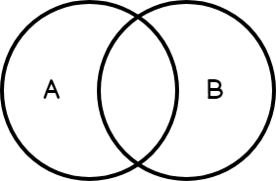
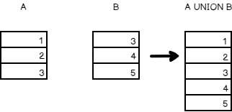
9.1 UNION
ពាក្យបញ្ជា UNION រួមបញ្ចូលគ្នានូវសំណុំលទ្ធផលនៃ SELECT Statement ពីរឬច្រើន (មានតែតម្លៃខុសគ្នាប៉ុណ្ណោះ)។

Slide 3
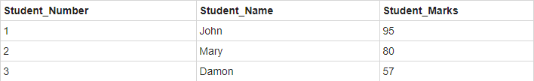
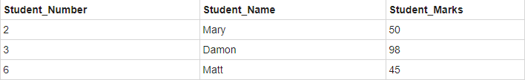
Example:
Table: Art_Student
Table: Dance_Student

Slide 4

Cont’d
Select Student_Name from Art_Student
UNION
Select Student_Name from Dance_Student
Result:

Slide 5
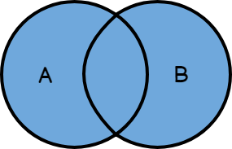
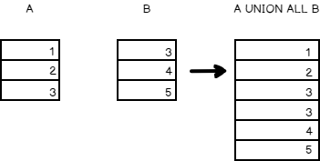
9.2 union all
បើក្រឡេកមើល Union vs Union​ All អ្វីដែលយើងរកឃើញថាពួកគេមានលក្ខណៈប្រហាក់ប្រហែលគ្នាប៉ុន្តែពួកគេមានភាពខុសគ្នាសំខាន់ៗ។

Slide 6
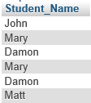
Example:
Select Student_Name from Art_Student
UNION ALL
Select Student_Name from Dance_Student

Slide 7
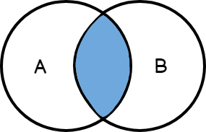
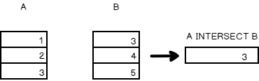
9.3 intersect
INTERSECT ត្រូវបានប្រើដើម្បីត្រឡប់លទ្ធផលនៃ SELECT Statement ចំនួន ២ រឺច្រើន។ ទោះយ៉ាងណាក៏ដោយវាត្រឡប់មកវិញតែជួរដេកទាំងឡាយណាដែល Table ទាំងមានដូចគ្នា។

Slide 8

Example:
Select Student_Name from Art_Student
INTERSECT
Select Student_Name from Dance_Student

Slide 9
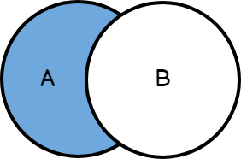
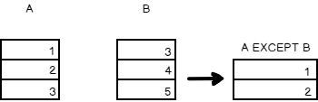
9.4 Except

Slide 10

Example:
Select Student_Name from Art_Student
EXCEPT
Select Student_Name from Dance_Student

Slide 11
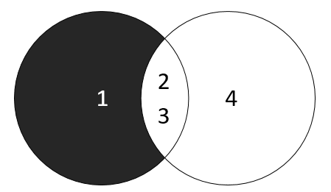

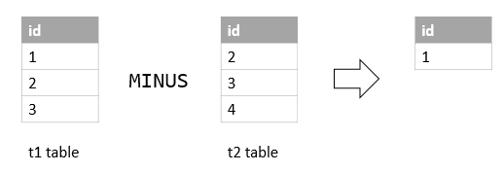

9.5 minus

Slide 12
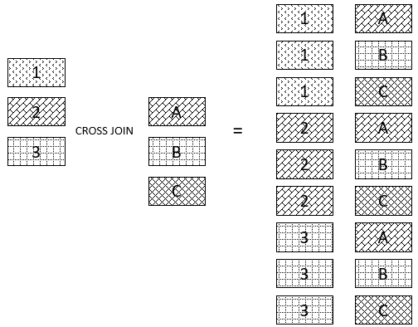
9.4 cross join
CROSS JOIN បានចូលរួមគ្រប់ជួរពីតារាងទីមួយ (T1) ជាមួយជួរទាំងអស់ពីតារាងទីពីរ (T2) ។

Slide 13
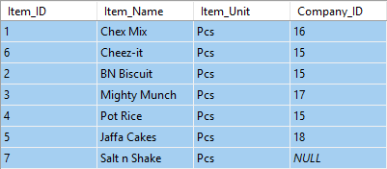
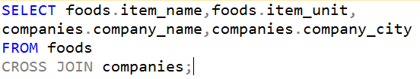
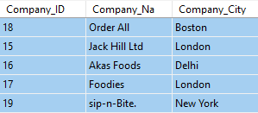
Example:
Table: foods
Table: companies

Slide 14
9.5 Natural Join
ធ្វើការតែនៅពេល Table 2 មានជួរឈរមានឈ្មោះនិងប្រភេទដូចគ្នាតែមួយដែលជាកូនសោចូលរួម។ Natural Join គឺជិតដូចគ្នានឹង INNER JOIN លើកលែងតែជួរឈរដដែលៗត្រូវបានជៀសវាង។ នៅពេលប្រើពាក្យ NATURAL JOIN ពាក្យគន្លឹះ ON និង USING មិនគួរត្រូវបានអនុញ្ញាត។ មិនមែនគ្រប់ RDBMS បានអនុវត្ត NATURAL JOIN ទេ។

Slide 15

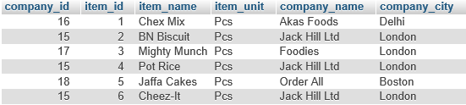
Example:
Table: Foods
Table: Companies

Slide 16
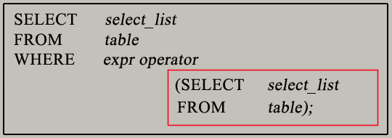
9.6 subqueries
Subquery ឬ Inner Query ឬ Nested Query គឺជា query មួយនៅក្នុង query មួយផ្សេងទៀតនិងបង្កប់ក្នុងឃ្លា WHERE ។ Subquery មួយត្រូវបានប្រើដើម្បីបញ្ជូនទិន្នន័យដែលនឹងត្រូវបានប្រើនៅក្នុងសំណួរចម្បងដែលជាលក្ខខណ្ឌដើម្បីរឹតបន្តឹងទិន្នន័យដែលត្រូវទាញយកមកវិញ។ Subqueries អាចត្រូវបានប្រើជាមួយ SELECT, INSERT, UPDATE, និង DELETE រួមជាមួយប្រតិបត្តិករដូចជា =, <,>,> =, <=, IN, BETWEEN ។ ល។
Syntax:

Slide 17
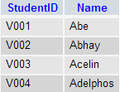
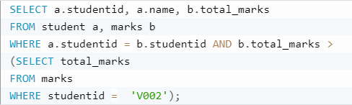
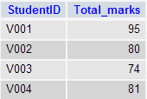

Example: subqueryies with selete
Table: Student
Table: Marks

Slide 18
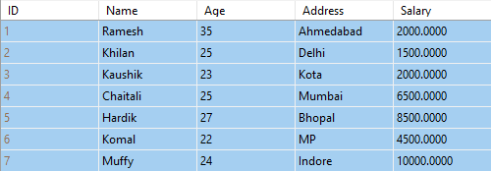
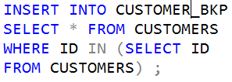
Example: subqueries with insert
Table: Customers
Table: customer_BKP

Slide 19
Example: subqueries with update
Table: Customers
UPDATE CUSTOMERS
SET SALARY = SALARY * 0.25
WHERE AGE IN
(SELECT AGE FROM CUSTOMER_BKP
WHERE AGE >= 27 );

Slide 20
Example: subqueries with delete
Table: Customers
DELETE FROM CUSTOMERS
WHERE AGE IN (SELECT AGE FROM CUSTOMERS_BKP
WHERE AGE >= 27 );

Slide 21
9.7 Correlated Subqueries
ALL: Used to retrieve records from the main query that match all of the records in the subquery.
ANY: Used to retrieve records from the main query that match any of the records in the subquery.
EXISTS: Used to check for the existence of a value in the subquery.
IN: Used to compare values in a column against column values in another table or query.
NOT: Used to match any condition opposite of the one defined.
SOME: Used to retrieve records from the main query that match any of the records in the subquery.

Slide 22
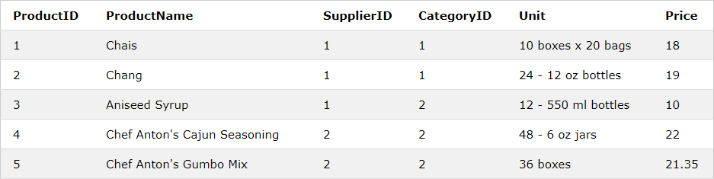
9.7.1 All
Syntax:
SELECT column_name(s) FROM table_name WHERE column_name operator ALL (SELECT column_name FROM table_name WHERE condition);
Table: Product

Slide 23
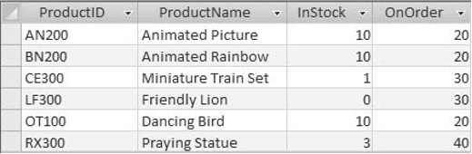
Example:
Suppose you want to query the Products table to retrieve product information on products that have less than 20 items in stock. Look at the following script:
SELECT ProductID, ProductName, InStock, OnOrder
FROM Products
WHERE InStock < ALL (SELECT InStock FROM Products WHERE InStock = 20)
Result:

Slide 24
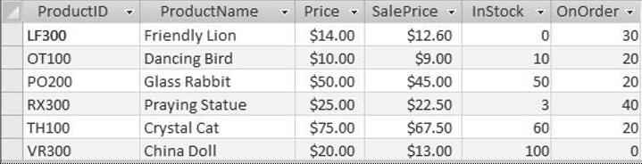
9.7.2 Any
Suppose you want to query the Products table in and the Transactions table to display product information on products that have a productID greater than any productID sold on February 6, 2007. Look at the following script:
SELECT *
FROM Products
WHERE ProductID > ANY (SELECT ProductID FROM Transactions
WHERE DateSold = #2/6/07#)
Result:

Slide 25
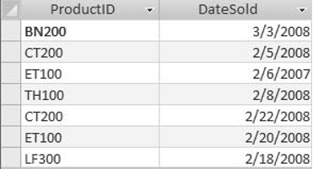
9.7.3 exists
Suppose you want to query the Customers table and the Transactions table to retrieve productIDs and dates for products purchased by customers who live in Florida. Look at the following script:
SELECT ProductID, DateSold
FROM Transactions
WHERE EXISTS (SELECT CustomerID FROM Customers
WHERE Customers.CustomerID = Transactions.CustomerID
AND State = 'FL’)
Result:

Slide 26
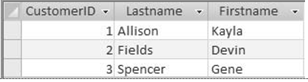
9.7.4 IN
Suppose you want to query the Customers table and the Sales table in to retrieve customers who purchased product ID CT200 or productID PO200. Look at the following script:
SELECT CustomerID, Lastname, Firstname FROM Customers
WHERE CustomerID IN
(SELECT CustomerID FROM Sales
WHERE ProductID = 'CT200' OR ProductID = 'PO200’)
Result:

Slide 27
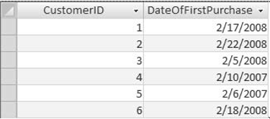
9.8 Nested Subqueries
Suppose you want to query the Customers table and the Sales table to retrieve the customerID and date of each customer’s first purchase.
SELECT CustomerID, (SELECT MIN (DateSold) FROM Sales
WHERE Sales.CustomerID = Customers.CustomerID) AS DateOfFirstPurchase
FROM Customers
ORDER BY CustomerID
Result:

